Slide 1

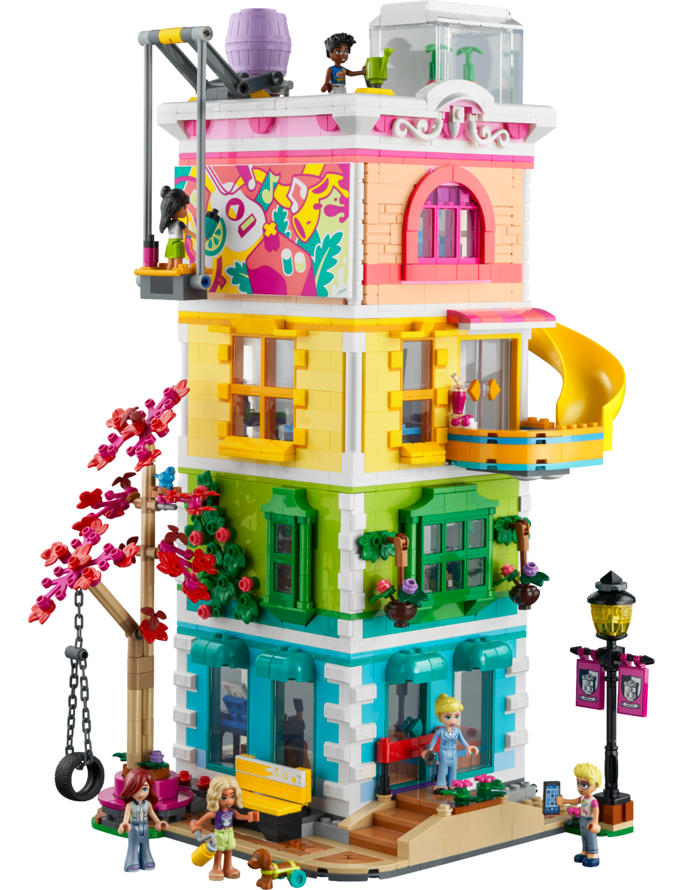
LEGO
joshua

Slide 2
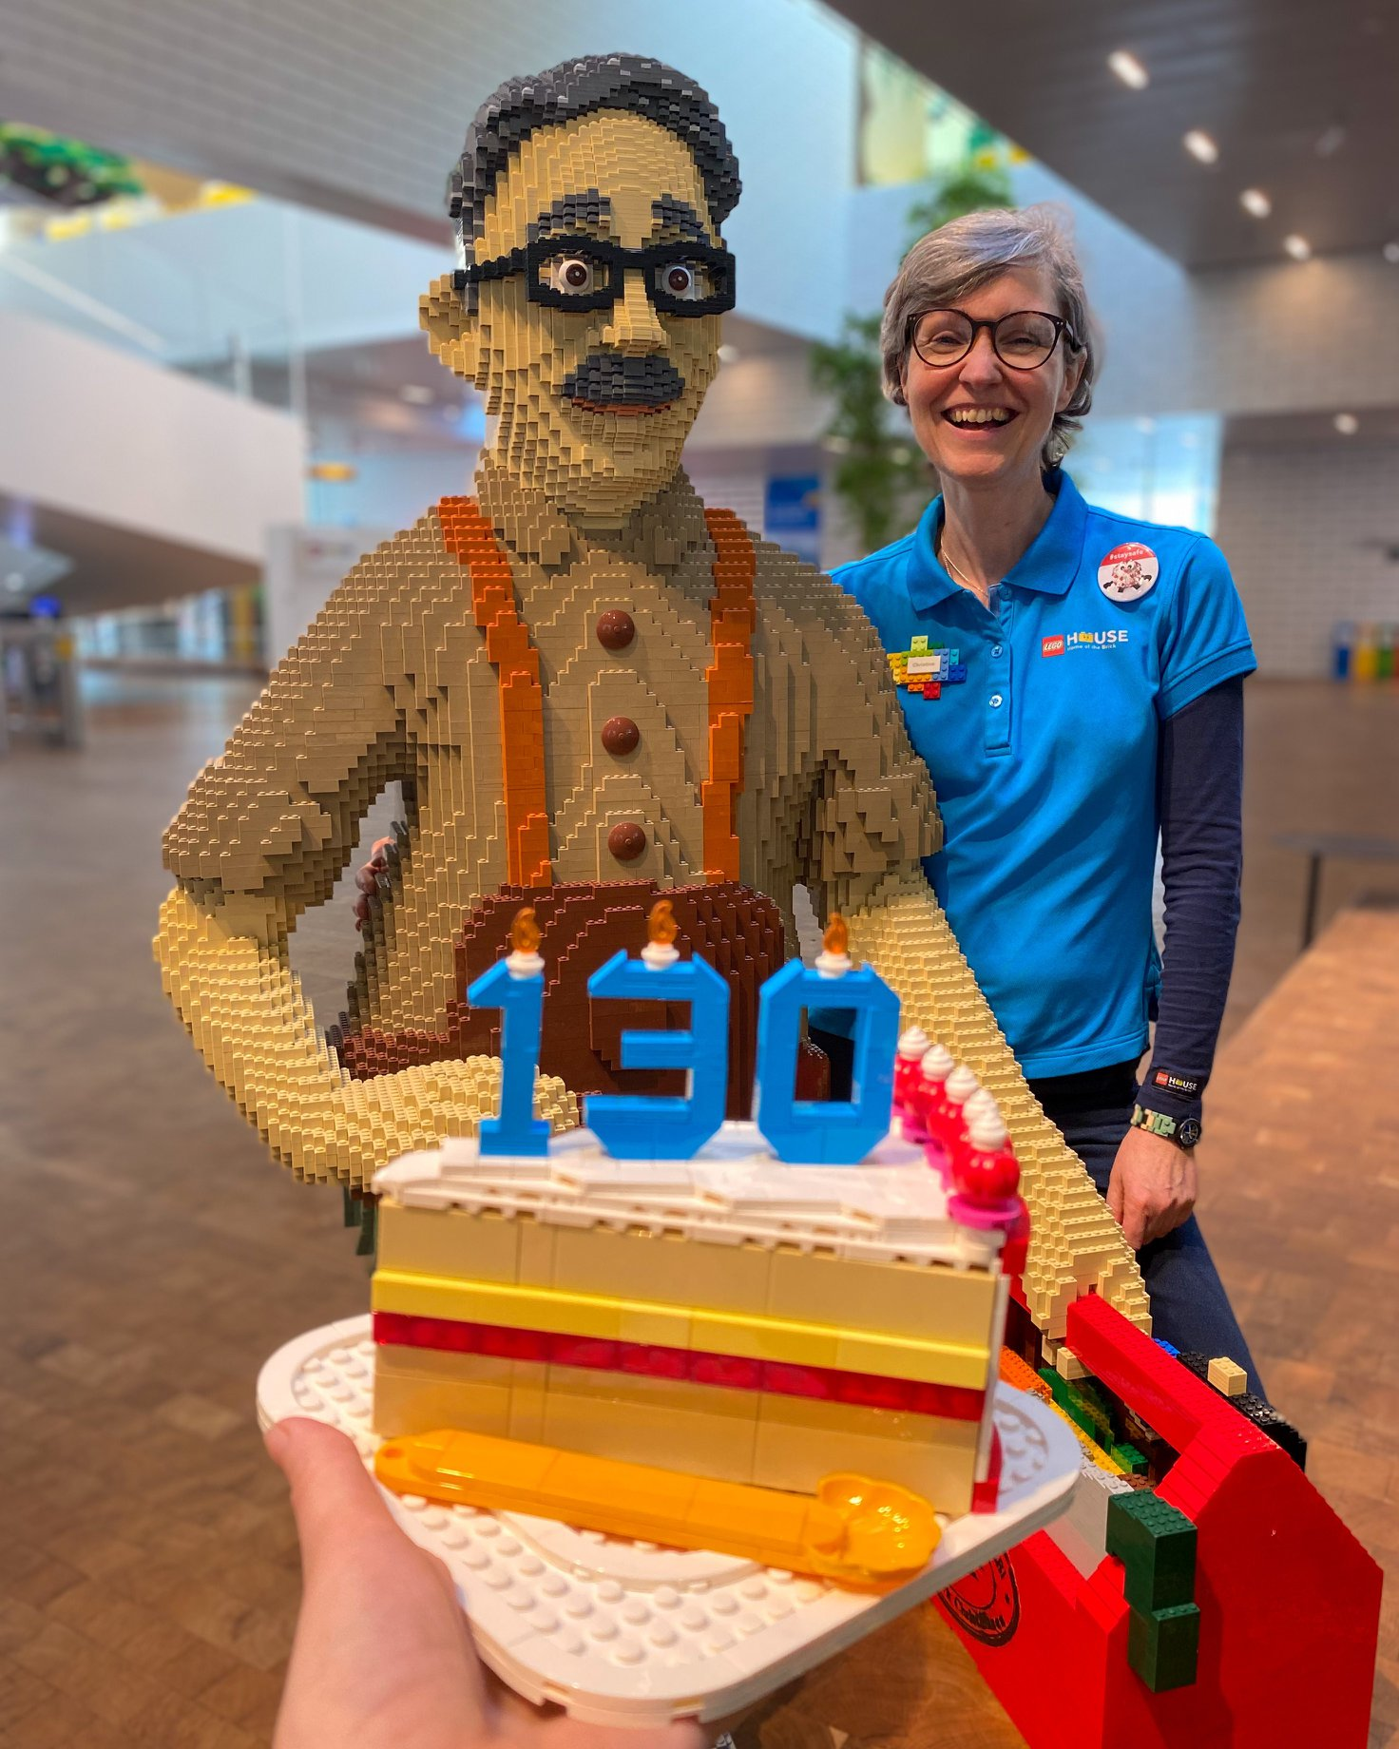
Background
Founded by ole kirk christiansen
Founded in 1932

Slide 3

Industry
Toy industry
Interlocking plastic bricks

Slide 4
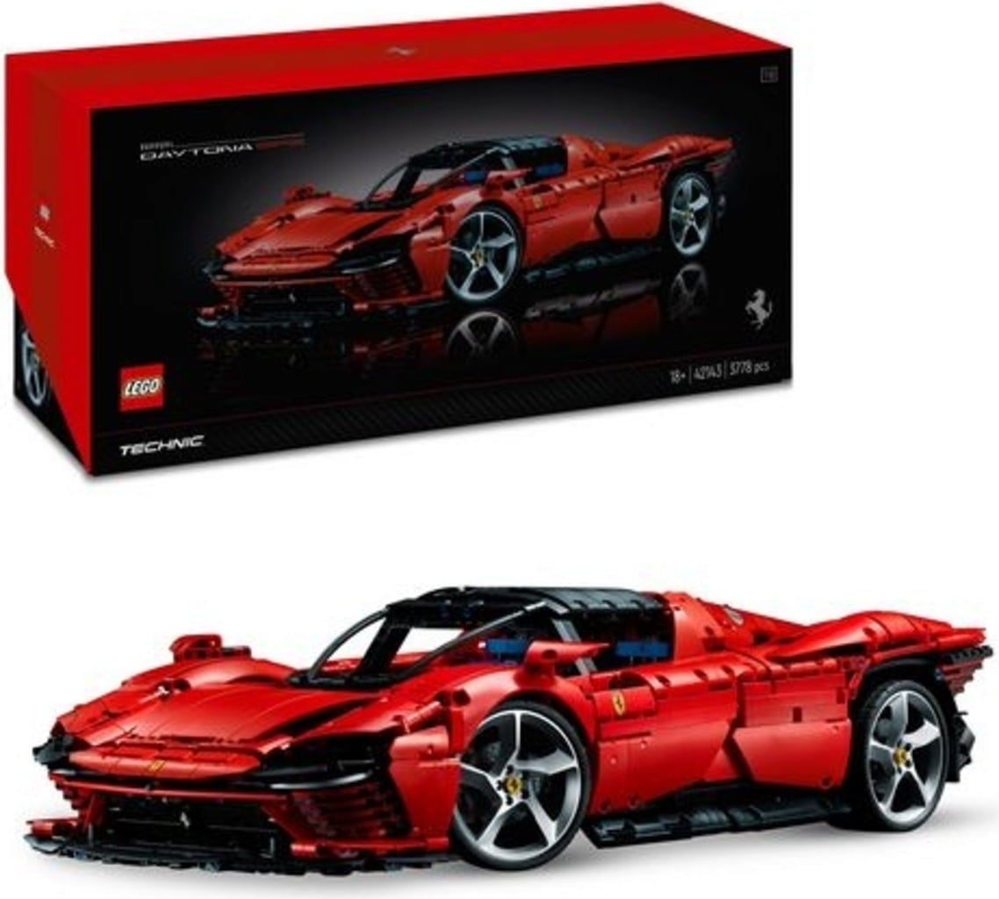
Publicly Traded
No

Slide 5
Producing Revenue
$8.06 billion usd 2021

